Slide 1
Relational Query Languages

Slide 2
Languages of DBMS
Data Definition Language DDL
define the schema and storage stored in a Data Dictionary
Data Manipulation Language DML
Manipulative populate schema, update database
Retrieval querying content of a database
Data Control Language DCL
permissions, access control etc...

Slide 3
Data Manipulation Language
Theory behind operations is formally defined and equivalent to a first-order logic (FOL)
Relational Calculus (∀, ∃ ) ≡ Relational Algebra
Relational algebra is a retrieval query language based on set operators and relational operators

Slide 4
Relational operators transform either a single relation or a pair of relations into a result that is a relation that can be used as an operand on later operations
For every operator operand and result, relations are free of duplicates
Operators are tuple oriented or set oriented
Structured Query Language (SQL)
an ANSI standard for relational databases, based on relational algebra/calculus
SQL2 1992
SQL3 1998

Slide 5
Operations in the Relational Model
Theory behind operations is formally defined and equivalent to a first order logic (FOL)
Relational operators transform either a simple relation or a pair of relations into a result that is a relation
The result can be used as an operand on later activities
For every operand and result, relations are free of duplicates
Operators are tuple oriented or set oriented

Slide 6
Query Operators
Relational Algebra
tuple (unary) Selection, Projection
set (binary) Union, Intersection, Difference
tuple (binary) Join, Division
Additional Operators
Outer Join, Outer Union

Slide 7
A Retrieval DML Must Express
Attributes required in a result
target list
Criteria for selecting tuples for that result
qualifier
The relations that take part in the query
set generators
Independent of the instances in the database
Expressions are in terms of the database schema

Slide 8
Relational Algebra

Slide 9
SQL Retrieval Statement
SELECT[all|distinct]
{*|{table.*|expr[alias]|view.*}
[,{table.*|expr[alias]}]...}
FROM table [alias][,table[alias]] ...
[WHERE condition]
[CONNECT BY condition
[START WITH condition]]
[GROUP BY expr [,expr] ...]
[HAVING condition]
[{UNION|UNION ALL|INTERSECT|MINUS}
SELECT ...]
[ORDER BY {expr|position}
[ASC|DESC][,expr|position}[ASC|DESC].
[FOR UPDATE OF column [,column] ... [NOWAIT]]

Slide 10
π Project Operator
selects a subset of the attributes of a relation
attribute list are drawn from the specified relation;
if the key attribute is in the list then card(result) = card(relation)
Result = π _{(attribute list)}(relation name)
resulting relation has only the attributes in the list, in same order as they appear in the list
the degree(result) = number of attributes in the attribute list
no duplicates in the result

Slide 11
π Project Operator
π_{tutor}(STUDENT)

Slide 12
π Project Operator SELECT
select *
from student;
select tutor
from student;

Slide 13
σ Select Operator
selects a subset of the tuples in a relation that satisfy a selection condition
a boolean expression specified on the attributes of a specified relation
Result = σ _{(selection condition)}(relation name)
a relation that has the same attributes as the source relation;
stands for the usual comparison operators ‘<‘, ‘<>‘, ‘<=‘, ‘>‘, ‘>=‘, etc
clauses can be arbitrarily connected with boolean operators AND, NOT, OR
degree(result) = degree(relation);
card(result) <= card(relation)

Slide 14
σ Select Operator
σ_{name=‘bloggs’}(STUDENT)

Slide 15
retrieve tutor who tutors Bloggs
π_{tutor}(σ_{name=‘bloggs’}(STUDENT))
select tutor from student
where name = ‘bloggs’;

Slide 16
SQL retrieval expressions
select studentno, name from student
where hons != ‘ca’ and
(tutor = ‘goble’ or tutor = ‘kahn’);
select * from enrol
where labmark > 50;
select * from enrol
where labmark between 30 and 50;

Slide 17
select * from enrol
where labmark in (0, 100);
select * from enrol
where labmark is null;
select * from student
where name is like ‘b%’;
select studno, courseno,
exammark+labmark total from enrol
where labmark is not NULL;

Slide 18
Selection Example
Faculty (fnum, name, office, salary, rank)
12345 | Darcy | Car409 | 21000 | lecturer
23456 | Bob | Bac100 | 23000 | associate
34567 | Mary | Car301 | 27000 | associate
45678 | Jane | Irv342 | 32000 | full

Slide 19
Selection Example (cont’d)
σ _{salary > 27000} (Faculty)
σ _{rank = associate} (Faculty)
σ _{fnum = 34567} (Faculty)

Slide 20
Selection Example (cont’d)
σ(salary>26000) and (rank=associate) (Faculty)
σ(salary<=26000) and (rank !=associate) (Faculty)
σ_{max(salary)} (Faculty)

Slide 21
Selection (cont’d)
For the condition
any combination of expressions that can be resolved to a boolean value with the relation is okay
For the relation
any relational expression that resolves to a relation is okay

Slide 22
Back to the Dept & Phone example
σ_{code=comp} (department X dept_phone)
First, we resolve the cross product of Department and Dept_phone.
We then apply the select to the resulting relation.

Slide 23
Selection (cont’d)
σ is commutative
σ_{c1} (σ_{c2}(R)) = σ_{c2} (σ_{c1}(R))

Slide 24
Rename (←)
Used to give a name to the resulting relation
Notation to make relational algebra easier to write and understand
We can now use the resulting relation in another relational algebra expression
Notation:
<New Name> ← <Relational Expression>

Slide 25
Rename Example
Faculty (fnum, name, office, salary, rank)
Associates ← σ_{rank = associate}(Faculty)
Result ← π _{name} (Associates)
12345 | Darcy | Car409 | 21000 | lecturer
23456 | Bob | Bac100 | 23000 | associate
34567 | Mary | Car301 | 27000 | associate
45678 | Jane | Irv342 | 32000 | full

Slide 26

Rename
The first expression renames both the relation and its attributes, the second renames the relation only, and the third renames the attributes only.

Slide 27

Aggregate Functions and Grouping
<grouping attributes> is a list of attributes of the relation specified in R, and
<function list> is a list of (<function> <attribute>) pairs.
In each such pair,<function> is one of the allowed functions—such as SUM, AVERAGE, MAXIMUM, MINIMUM,COUNT
and <attribute> is an attribute of the relation specified by R.

Slide 28
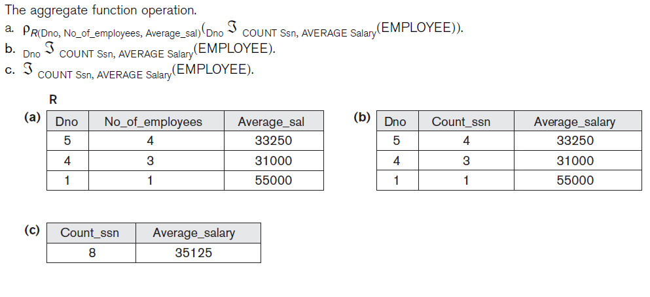
Aggregate

Slide 29
Cartesian Product Operator
Definition:
The cartesian product of two relations R1(A₁,A₂,...,A_{n}) with cardinality i and R2(B₁,B₂,...,B_{m}) with cardinality j is a relation R3 with degree k=n+m, cardinality i*j and attributes (A₁,A₂,...,A_{n},B₁,B₂,...,B_{m})
The result, denoted by R1XR2, is a relation that includes all the possible combinations of tuples from R1 and R2
Used in conjunction with other operations

Slide 30
Cartesian Product Example

Slide 31
X Cartesian Product

Slide 32
Set Theoretic Operators
Union, Intersection and Difference
Operands need to be union compatible for the result to be a valid relation
Definition:
Two relations
R1(A₁,A₂,...,A_{n}) and R2(B₁,B₂,...,B_{m})
are union compatible iff:
n = m and, dom(A_{i})= dom (B_{i}) for 1 ≤ i ≤ n

Slide 33
∪ Union Operator
Definition:
The union of two relations
R1(A₁,A₂,...,A_{n}) and R2(B₁,B₂,...,B_{m})
is a relation R3(C₁,C₂,...,C_{n}) such that dom(C_{i})= dom(A_{i}) =dom (B_{i}) for 1 ≤ i ≤ n
The result R1 ∪ R2 is a relation that includes all tuples that are either in R1 or R2 or in both without duplicate tuples
The resulting relation might have the same attribute names as the first or the second relation

Slide 34
Retrieve all staff that lecture or tutor
Lecturers π_{(lecturer)}TEACH
Tutors π_{(tutor)}STUDENT
Lecturers ∪ Tutors

Slide 35
∩ Intersection Operator
Definition: The intersection of two relations R1(A₁,A₂,...,A_{n}) and R2(B₁,B₂,...,B_{m}) is a relation R3(C₁,C₂,...,C_{n}) such that
dom(C_{i})= dom(A_{i}) ∩ dom (B_{i}) for 1 ≤ i ≤ n
The result R1 ∩ R2 is a relation that includes only those tuples in R1 that also appear in R2
The resulting relation might have the same attribute names as the first or the second relation

Slide 36
Retrieve all staff that lecture and tutor
Lecturers π_{(lecturer)}TEACH
Tutors π_{(tutor)}STUDENT
Lecturers ∩ Tutors

Slide 37
− Difference Operator
Definition: The difference of two relations R1(A₁,A₂,...,A_{n}) and R2(B₁,B₂,...,B_{m}) is a relation R3(C₁,C₂,...,C_{n}) such that
dom(C_{i})= dom(A_{i}) −dom (B_{i}) for 1 ≤ i ≤ n
The result R1 − R2 is a relation that includes all tuples that are in R1 and not in R2
The resulting relation might have the same attribute names as the first or the second relation

Slide 38
Retrieve all staff that lecture but don’t tutor
Lecturers π_{(lecturer)}TEACH
Tutors π_{(tutor)}STUDENT
Lecturers -Tutors

Slide 39
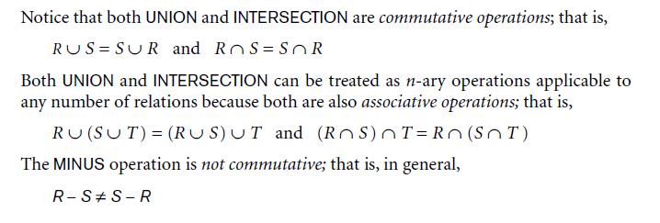

Set Operators

Slide 40
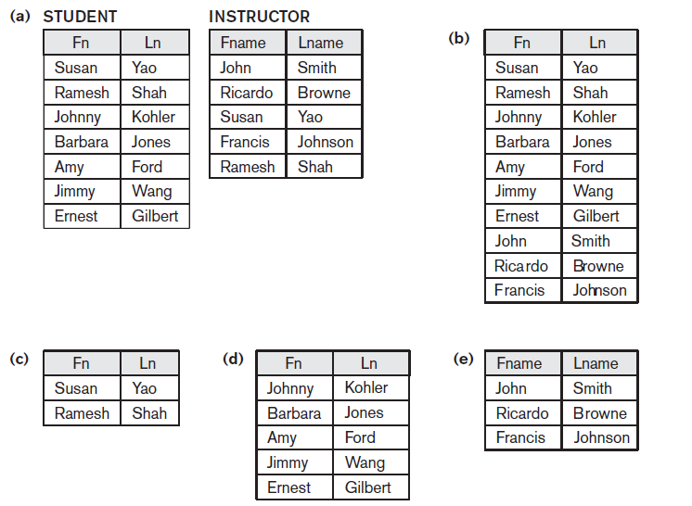
Set operators (cont)

Slide 41
θ Join Operator
Definition:
The join of two relations R1(A₁,A₂,...,A_{n}) and R2(B₁,B₂,...,B_{m}) is a relation R3 with degree k=n+m and attributes (A₁,A₂,...,A_{n}, B₁,B₂,...,B_{m}) that satisfy the join condition
Result = R1 _{(θ join condition)} R2
stands for the usual comparison operators ‘<‘, ‘<>‘, ‘<=‘, ‘>‘, ‘>=‘, etc
comparing terms in the Θ clauses can be arbitrarily connected with boolean operators AND, NOT, OR
The result is a concatenated set but only for those tuples where the condition is true.
It does not require union compatibility of R1 and R2

Slide 42
Join Operation
Join is a commonly used sequence of operators
Take the Cartesian product of two relations
Select only related tuples
(Possibly) eliminate duplicate columns

Slide 43
Join Example
R = S =
R1 ← R X S
R2 ← σ _{dcode = code} (R1)
Result ← π _{code, office, number} (R2)
dcode | number
COMP | 555-1111
HIST | 555-2222
code | office
COMP | CAR309
HIST | BAC333

Slide 44
Join Example (cont’d)
You could do all of that, or you could do a join
Result ← R ⋈ _{dcode = code} S

Slide 45
Kinds of Joins
There are 3 different kinds of joins
Theta join: A join with some condition specified
Equijoin: A join where the only comparison operator used is “=“
Most common since most joins link together related tuples using a foreign key

Slide 46
Kinds of Joins (cont’d)
Natural join
Is an equijoin followed by the removal of duplicate (superfluous) column(s)
When people talk about “joins”, this is the one we most often mean.
A Natural join is denoted by (*)
Standard definition requires that the columns used to join the tables have the same name
This is a good idea b/c it makes relationships more obvious

Slide 47

Nature Join

Slide 48
Size of a Natural Join
if R contain n_{R} tuples and S contain n_{S} tuples, then the size of R ⋈<>S is between 0 and n_{R}*n_{S}
join selectivity = Expected size of the result
n_{R} * n_{S}
This value is used by the optimizer to estimate the cost of the join.

Slide 49
Types of Joins
Left Outer Join
keep all of the tuples from the “left” relation
join with the right relation
pad the non-matching tuples with nulls
Right Outer Join
same as the left, but keep tuples from the “right” relation
Full Outer Join
same as left, but keep all tuples from both relations

Slide 50
Outer Join Operation
In an equi-join, tuples without a ‘match’ are eliminated
Outer join keeps all tuples in R1 or R2 or both in the result, padding with nulls
Left outer join R1 R2
keeps every tuple in R1
select * from R1, R2 where R1.a = R2.a (+)
Right outer join R1 R2
keeps every tuple in R2
select * from R1, R2 where R1.a (+) = R2.a
Double outer join R1 R2
keeps every tuple in R1 and R2
select * from R1, R2 where R1.a (+) = R2.a (+)

Slide 51
Left Outer Join
name phone
name email
A | B
C | D
A | F
G | H
R=
S=
If we do a left outer join on R and S, and we match on the first column, the result is:
name phone email
A | B | F
C | D | -

Slide 52
Outer Join Operator
select * from student, staff
where tutor = lecturer

Slide 53
Outer Join Operator
select * from student, staff
where tutor = lecturer (+)

Slide 54
Right Outer Join
name phone
name email
A | B
C | D
A | F
G | H
R=
S=
If we do a right outer join on R and S, and we match on the first column, the result is:
name phone email
A | B | F
G | - | H

Slide 55
Full Outer Join
name phone
name email
A | B
C | D
A | F
G | H
R=
S=
If we do a full outer join on R and S, and we match on the first column, the result is:
name phone email
A | B | F
C | D | -
G | - | H

Slide 56
Self Join: Joins on the same relation
π _{(lecturer,} (staff _{(appraiser = lecturer)} staff) _{roomno,appraiser, approom)}
select e.lecturer, e.roomno, m.lecturer appraiser, m.roomno approom
from staff e, staff m
where e.appraiser = m.lecturer

Slide 57
Outer Self Join
π _{(lecturer,} (staff _{(appraiser = lecturer)} staff) _{roomno,appraiser, approom)}
select e.lecturer, e.roomno, m.lecturer appraiser, m.roomno approom
from staff e, staff m
where e.appraiser = m.lecturer (+)

Slide 58
÷ Division Operation
Definition: The division of two relations R1(A₁,A₂,...,A_{n}) with cardinality i and R2(B₁,B₂,...,B_{m}) with cardinality j is a relation R3 with degree k=n-m, cardinality i*j and attributes
(A₁,A₂,...,A_{n},B₁,B₂,...,B_{m})
that satisfy the division condition
The principle algebraic counterpart of queries that involve the universal quantifier ∀
Relational languages do not express relational division

Slide 59
÷ Division Operation Example
Retrieve the studnos of students who are enrolled on all the courses that Capon lectures on
Small_ENROL ÷ Capon_TEACH
the tuples in the denominator relation S restrict the numerator relation R
by selecting those tuples in the result that match all values present in the denominator.

Slide 60
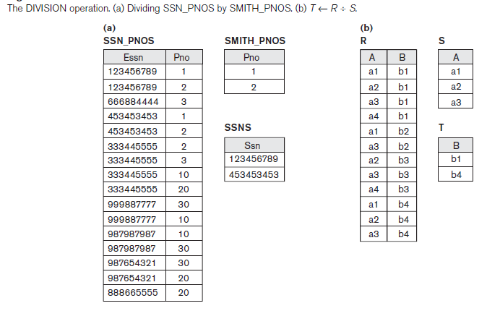

Slide 61
Completeness of Relational Algebra
Five fundamental operations
σ π X ∪ —
Additional operators are defined as combination of two or more of the basic operations,
e.g. R1 ∩ R2 = R1 ∪ R2 — ((R1 — R2) ∪ (R2—R1) R1 _{<condition>}R1 = σ_{<condition>}(R1 X R2)

Slide 62
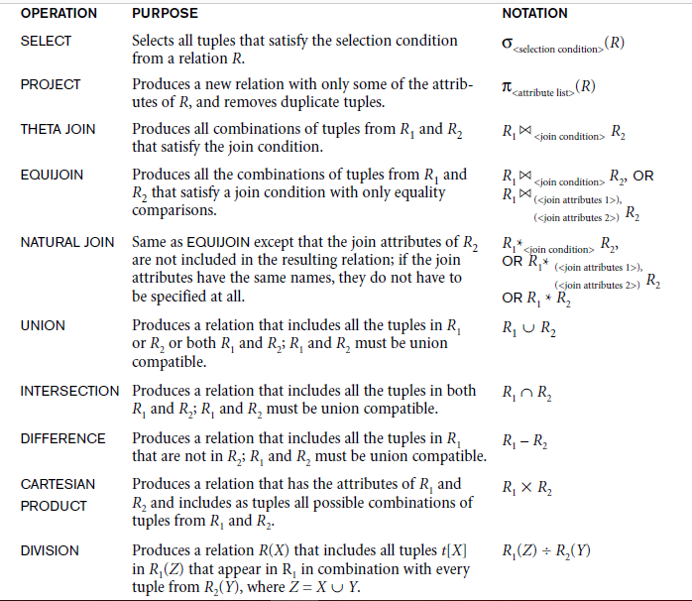
Operations of Relational Algebra

Slide 63
Query Tree
notation typically used in relational systems to represent queries internally
query evaluation tree or query execution tree
A query tree is a tree data structure that corresponds to a relational algebra expression.
It represents the input relations of the query as leaf nodes of the tree, and represents the relational algebra operations as internal nodes.

Slide 64

For every project located in ‘Stafford’, list the project number, the controlling department number, and the department manager’s last name, address, and birth date.

Slide 65
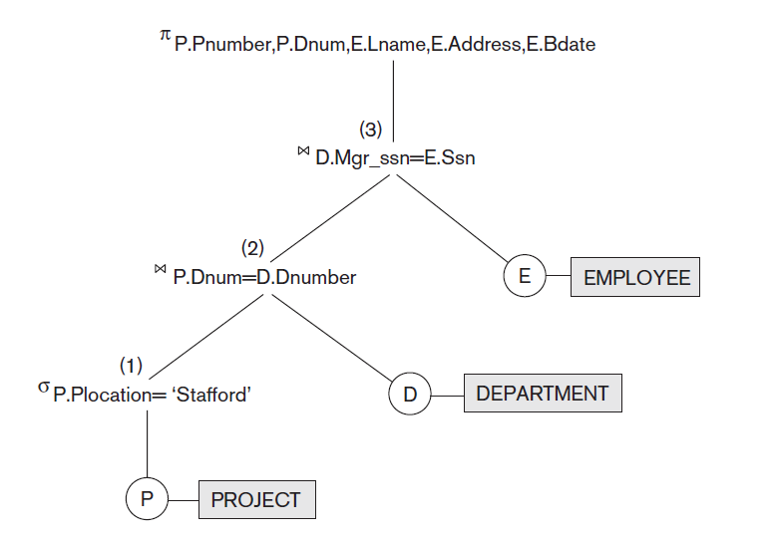
Query Tree

Slide 66
Exercise
Get student’s name, all their courses, subject of course, labmark for course, lecturer of course and lecturer’s roomno for ‘ca’ students
University Schema
STUDENT(studno,name,hons,tutor,year)
ENROL(studno,courseno,labmark,exammark)
COURSE(courseno,subject,equip)
STAFF(lecturer,roomno,appraiser)
TEACH(courseno,lecturer)
YEAR(yearno,yeartutor)

